Slide 1
Lecture 4
Top-Down Parsing

Slide 2
OutLine
4.1 The Condition of Predictive Parsing
4.2 Recognition of LL(1) Grammar
4.3 Non LL(1) grammar to LL(1) grammar
4.4 Recursive-Descent Parsing
4.5 LL(1) Parsing
4.6 Error Recovery in Top-Down Parsers

Slide 3
4.4 Top-Down Parsing by Recursive-Descent
Main Idea of Recursive-Descent
Define a procedure for each nonterminal A that will recognize A
The right-hand side of the grammar rule for A specifies the structure of the code for this procedure of A
Terminals correspond to matches of the input
Nonterminals correspond to calls to other procedures
Choices correspond to alternatives (case or if statement) within the code
We will talk about:
General method for constructing Recursive-Descent parser based on BNF
A simpler method based on EBNF

Slide 4
General method for Constructing Recursive-Descent parser
Determine whether the grammar is LL(1)
1) After left recursion removal we get grammar G':
E→TE' E'→+TE'│ε
T→FT' T'→*FT'│ε
F→(E)│i
Example
Grammar G
E→E+T│T
T→T*F│F
F→(E)│i

Slide 5
2) Compute First Set and Follow Set for G’.
E→TE' E'→+TE'│ε T→FT' T'→*FT'│ε F→(E)│i
 | nullable | First | Follow
E | no | { (, i } | { ), $ }
E’ | yes | { +, ε} | { ), $ }
T | no | { (, i } | { +, ), $ }
T’ | yes | { *, ε} | { +, ), $ }
F | no | { (, i } | { *, +,),$}
+TE’ |  | {+}
*FT’ |  | {*}
(E) |  | {(}
i |  | {i}
G’ is LL(1) grammar

Slide 6
Constructing Recursive-Descent parser
2. Construct Recursive-Descent Parser for G’
consists of a main procedure and a group of recursive procedures, each corresponds to a nonterminal of the grammar
Variable used:
TOKEN is a variable that keeps the current next token in the input
Special Sub-procedures used :
match(y) is a procedure that matches the current next token TOKEN with its parameter y , advances the input if it succeeds, and declares error if it does not
error is a procedure that prints an error message and exit

Slide 7
Constructing Recursive-Descent parser
If productions of nonterminal U are
U → x1 | x2 |…|xn, and x1,...,xn≠ ε, then the code for procedure U is as follow:
if TOKEN in First(x1) then p_x1
else if TOKEN in First(x2) then p_x2
else …
….
else if TOKEN in First(xn) then p_xn
else ERROR

Slide 8
Constructing Recursive-Descent parser
If a production of U is U → ε, then rewrite code
if TOKEN in First(xn) then p_xn
else ERROR
into
if TOKEN in First(xn) then p_xn
else if TOKEN not in Follow(U) then ERROR
The code for p_x where x=y1y2…yn is:
begin p_y1;p_y2;…;p_yn end
if yi∈V_{N} then p_yi is the call of procedure yi；otherwise, if yi∈V_{T} then p_yi is match(yi)

Slide 9
Example:Recursive-descent parser for G’
E→TE ' E'→+TE'│ε
T→FT ' T'→*FT'│ε
F→(E)│i
(1) program MAIN; /* main */
begin
GETNEXT (TOKEN);
E ; /* call E */
if TOKEN ≠‘$' then ERROR
end.

Slide 10
(2) procedure E; /*E→TE'*/
begin
T; /*call T*/
E’ /*call E’*/
end;
(3) procedure T; /*T→FT' */
begin
F; /*call F*/
T’ /*call T’*/
end;

Slide 11
(4) procedure E’; /*E'→+TE'│ε*/
begin
if TOKEN=’+’ then /*E'→+TE'*/
begin
match(‘+’);
T; /*call T*/
E’ /*call E’*/
end
else /*E’ → ε*/
if TOKEN≠’)’ and TOKEN≠’$’ then ERROR
end;
 | nullable | First | Follow
E’ | yes | { +, ε} | { ), $ }

Slide 12
(5) procedure T'; /* T'→*FT'│ε */
begin
if TOKEN = '*' then /* T'→*FT' */
begin
match(‘*’);
F; /* call F */
T' /* call T’ */
end
else /* T‘→ε*/
if TOKEN≠'+‘ and TOKEN≠')' and TOKEN≠‘$'
then ERROR
end;

Slide 13
(6) procedure F; /* F→(E)│i */
begin
if TOKEN = '(' then /*F→(E) */
begin
match(‘(’);
E; /* call E */
match(‘)’)
end
else /* F→i */
if TOKEN=‘i’ then match(‘i’)
else error;
end;

Slide 14
A simpler method based on EBNF
Notations of EBNF (extended BNF)
{ } is used to express repetition
Example G
E→E+T│T
T→T*F│F
F→(E)│i
rewrite G into EBNF as G':
E → T {+ T}
T → F {* F}
F → (E) | i

Slide 15
[ ] is used to surround options
Example:
if-stmt->if (exp) stmt
| if (exp) stmt else stmt
is written as
if-stmt->if (exp) stmt [else stmt]

Slide 16
Construct Recursive-Descent Parser for G’
{ } is translated into the code for a while loop
[ ] is translated into a test in the code
The method of turning grammar rules in EBNF into code is quite powerful

Slide 17
E→ T {+ T}
(1) procedure E;
begin
T;
while token=‘+’ do
match(‘+’);
T;
end while;
end
T → F {* F}
(2) procedure T;
begin
F;
while token=‘*’ do
match(‘*’);
F;
end while;
end

Slide 18
if-stmt → if (Exp) Stmt [else Stmt]
can be translated into the procedure:
Procedure ifStmt;
begin
match(‘if’);
match(‘(‘);
Exp;
match(‘)’);
Stmt;
if token=‘else’ then
match(‘else’);
Stmt;
end if;
end ifStmt;

Slide 19
Actions for Constructing a Syntax Tree
3. Actions for Constructing a Syntax Tree
A parser should construct the appropriate syntax tree
The syntax tree for
“3+4+5” is
+
+
5
3
4

Slide 20
Actions for Constructing a Syntax Tree
Sub-functions used
MakeOpNode(op) that receives an operator token op as a parameter and returns a newly constructed syntax tree node
leftChild(t):=p or rightChild(t):=p indicates the assignment of a syntax tree p as a left or right child of a syntax tree node t

Slide 21
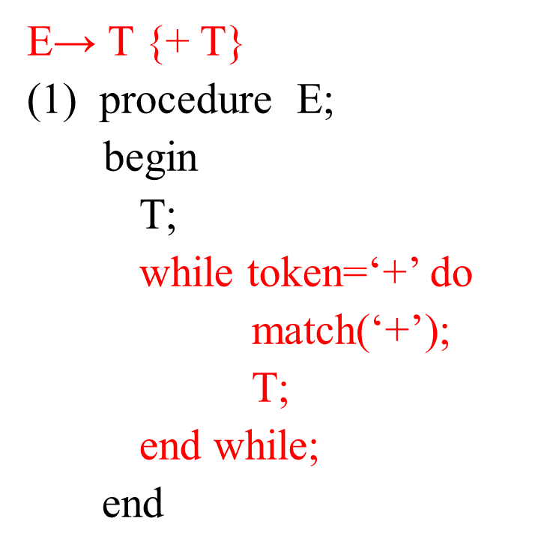
Action for Constructing a Syntax Tree
function E:syntaxTree; /* E → T {+ T} */
var temp,newtemp:syntaxTree;
begin
temp:=T;
while token=‘+’ do
match(‘+’);
newtemp:=makeOpNode(token);
leftChild(newtemp):=temp;
rightChild(newtemp):=T;
temp:=newtemp;
end while;
return temp;
end

Slide 22
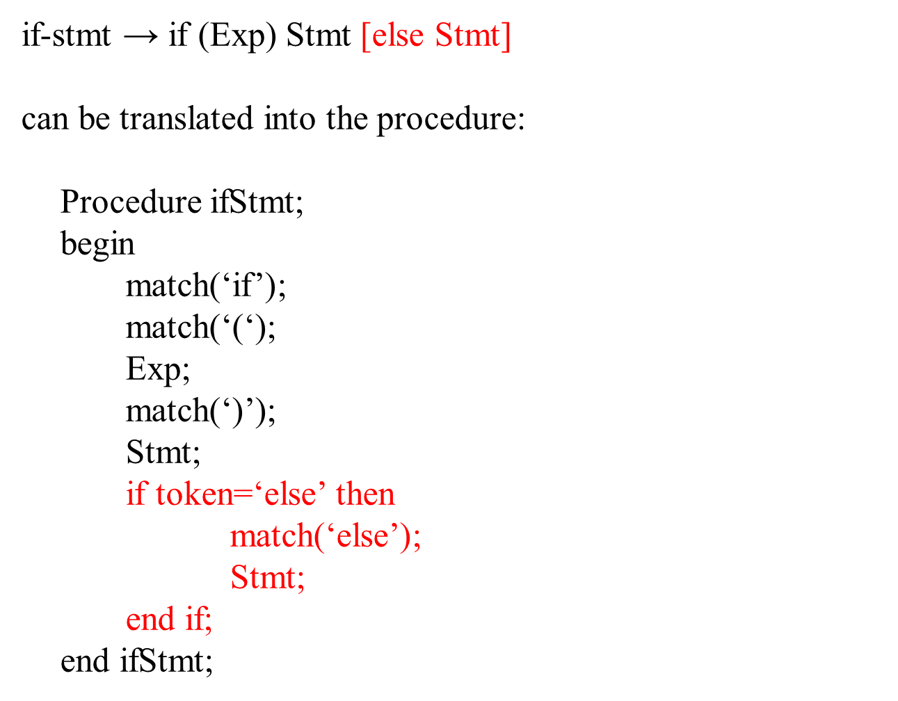
function ifStmt: syntaxTree;
/* if-stmt → if (Exp) Stmt [else Stmt] */
var temp :syntaxTree;
begin
match(‘if’);
temp:=makeStmtNode(‘if’);
match(‘(‘);
testChild(temp):=Exp;
match(‘)’);
thenChild(temp):=Stmt;
if token=‘else’ then
match(‘else’);
elseChild(temp):=Stmt;
else
elseChild(temp):=nil;
end if;
return temp;
end

